Slide 1

Lab 6: RC Circuits
PHY2049L
Section: 016

Slide 2
Learning Outcomes
Students will learn to use an oscilloscope to measure time varying signals.
Students will construct an RC circuit and measure the time constant of the circuit.
Students will gain an understanding of the meaning of the time constant the factors that will affect it.

Slide 3
AC Current/Voltage
Alternating current
Used everywhere.
Is an electric current in which the flow of electric charge periodically reverses direction, whereas in direct current (DC, also dc), the flow of electric charge is only in one direction.
Why is this more useful?

Slide 4
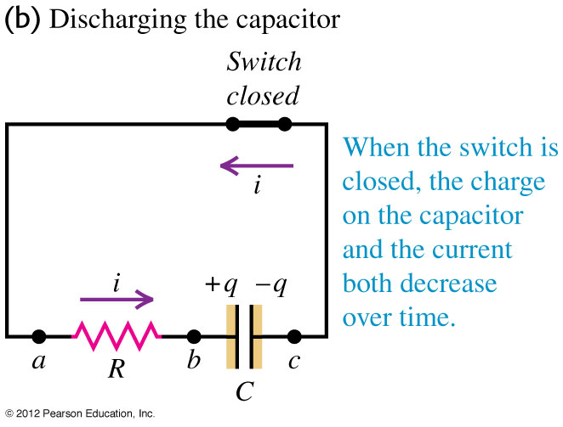
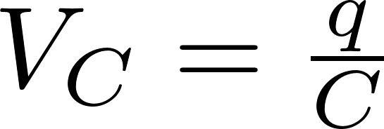
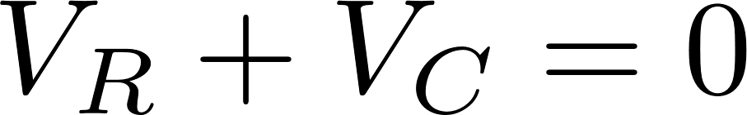
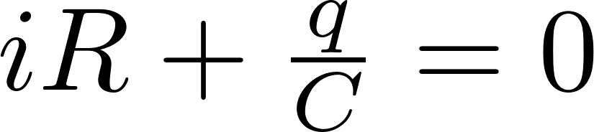
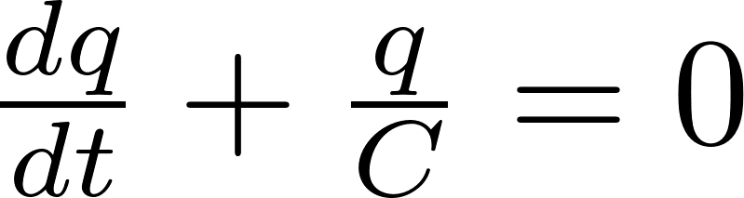
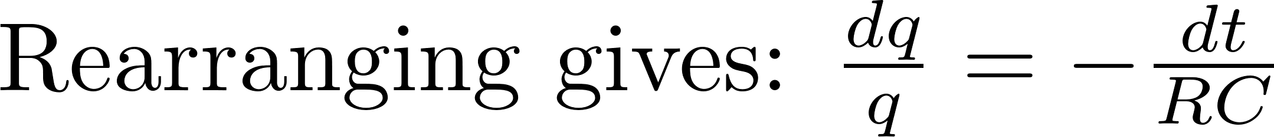
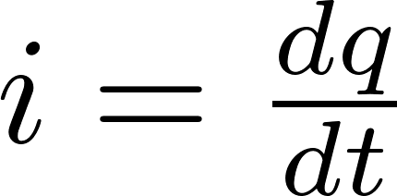
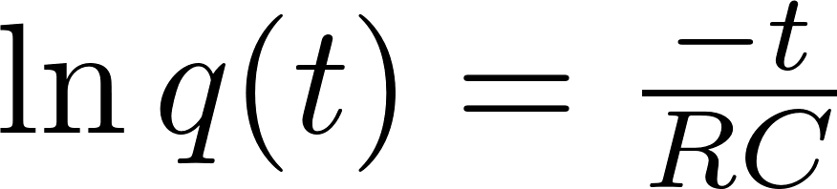
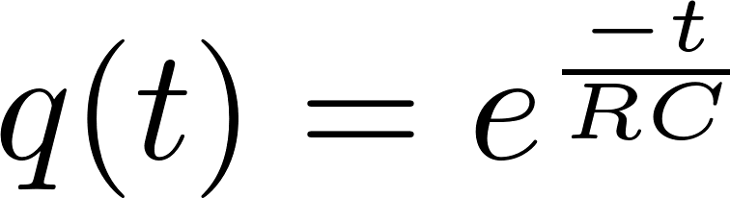
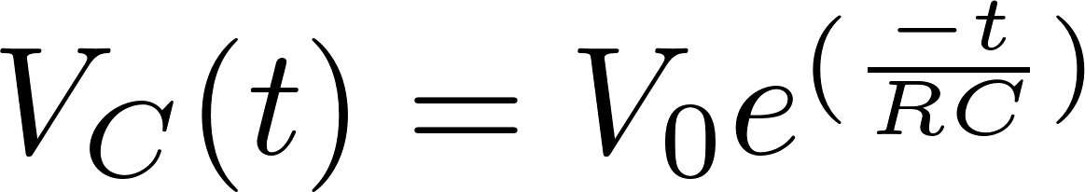
RC Circuit
The RC circuit is the most simple time varying circuit to construct. When using a DC source, we can use Kirchoff’s loop rule to find the volatge across the capacitor.

Slide 5
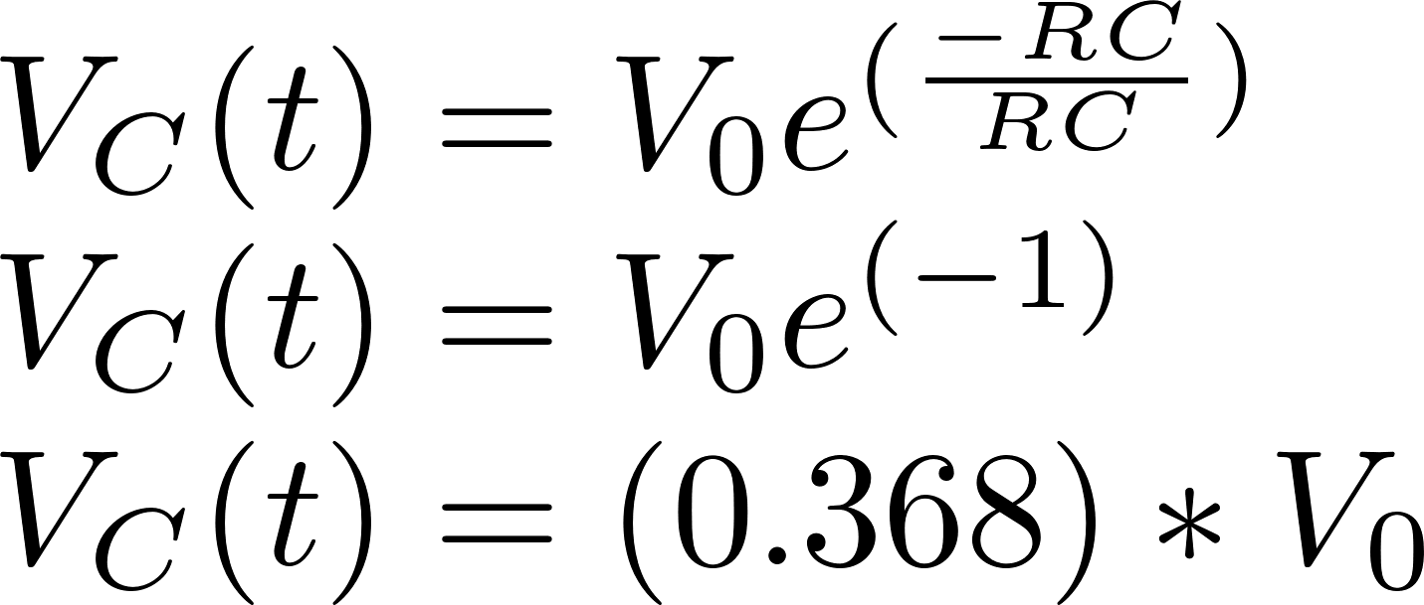
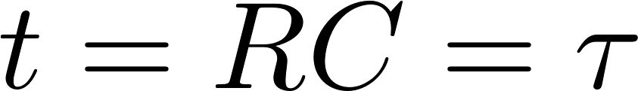
Time Constant
The time constant tells you how long it takes for the voltage/current to be reduced to approximately 36.8% (1/e) of its original value for a discharging capacitor.
This occurs when:

Slide 6
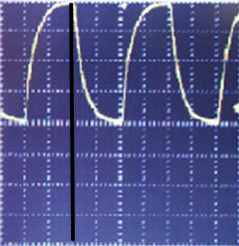
On Oscilloscope
This is what you will observe on your oscilloscope. The black line indicates the capacitor is fully charged. The voltage across the capacitor is decreasing over time.
The time it takes for the voltage measured across the capacitor to reach 0.368*V_{initial} is the time constant τ.
Count the number of divisions between t = 0 and t = τ, to measure the time constant.
0.368*V_{initial}
t = 0
t = τ

